Slide 1
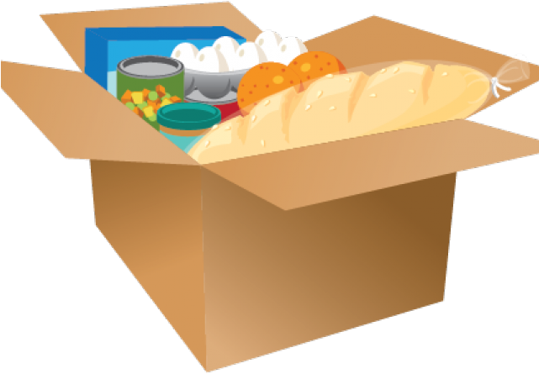
Food Donations
Workshop in Data-Centered Crowdsourcing
By Yahav, Adi, Shirly & Or

Slide 2

Project Description
A website for food donations.
The purpose of the website is to help those in need of food and to reduce food waste.
The website creates easy connections between food donors, the people who wish to receive it and volunteers that help with transferring the food.
The matches are based on food types and locations.

Slide 3

Target Audience
Donors
businesses: restaurant, catering service, bakery etc
private person
Volunteers
anyone who can help with transferring the donations and labeling them correctly, on their way or on their free time.
Recipients
anyone who is in need of food: families, elderly, lone soldiers etc.

Slide 4

The Donation Process
Adding Donations
Labeling Donations
Picking Donations
Delivering Donations
A donor uploads a new donation, including:
- location
- description and/or image
- number of potential recipients
- description and/or image
- time range
- tags for filtering
Volunteers browse through the open donations, adding tags based on the image and description, to ease the filtering for the other users.
A potential recipient browses through the open donations, filters them by the location and tags, and finds a donation.
- He reserves the part of the donation that he wants for a limited time, in which he comes to pick up the donation.
- Alternatively, in case he is unable to pick it up himself, he opens a request for delivery.
A Volunteer browses through the open requests for delivery and finds a request he can deliver, based on location. He marks it and delivers it from the donor to the recipient who opened the request.

Slide 5
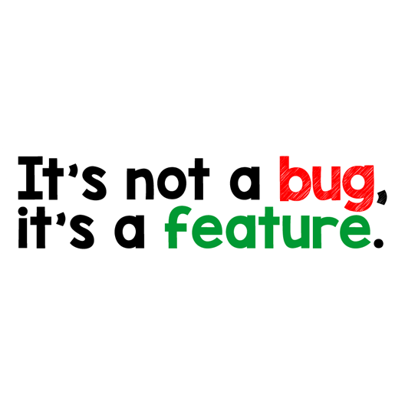
Problems & Solutions
Credibility Score
Will be given by users to reliable donors and volunteers.
Purpose - avoiding unreliable users.
Implementation - the recipient will update the score after successful or unsuccessful deliveries (bad food / didn’t get the delivery etc). Unreliable users will be removed from the website.
Tagging Score
Will be given by the website to volunteers who supply correct tags.
Purpose - avoiding unreliable tags.
Implementation - each tag will have a sum of the tagging scores of all the users who suggested that tag. A tag with a sum >= 4 will be considered a correct tag. The tag will be added to the donation and the tagging score of the users will increase.

Slide 6
Problems & Solutions
Prediction For Number Of Potential Recipients
Will be calculated based on volunteers’ predictions.
Purpose - predicting the number of potential recipients in case the donor did not specify it in the donation form.
Implementation - volunteers can suggest the number of recipients (2 ,20 etc).
For small number of predictions the predicted value will be the median of the values (less sensitive to extreme scores), and for a large number - the mean (less memory space).
Top Contributors
Will be shown on the website main page.
Purpose - motivating users to take part in the donation process.
Implementation - each user will have a “gratitude score” calculated by the formula that takes into account all of the helping methods.
(number_of_past_donations * 2 + number_of_past_deliveries * 2 + tagging_score)

Slide 7
Assumptions
Recipients credibility
We assume the recipients will be people who really need the food and not people who take it while they can afford it themselves.
The reason for the decision - we rather have the food taken by people that aren’t in need than the food being thrown away.
Partial solution - users who take a lot of donations in a short period of time will be logged by the server to be investigated.

Slide 8
Screens
Demo

Slide 9

Crowdsourcing
The website depends on the users to take actions and share information:
Uploading donations
Uploading profile data
Tagging the donations
Predicting recipients amount
Creating delivery requests
Delivering the donations
Rating users’ reliability

Slide 10
Work Plan
Building Foundation - done
Planning the website - all team members
Basic map demo - all team members
Designing the screens - Or
Html & screens’ connections - Yahav & Adi
Building the DB - Shirly
Implementing features
Divided among the team members by models,
based on the shared utilities (DB access, templates, logging, tests etc).

Slide 11



Software Choices
Python
Flask
SQLAlchemy

